Slide 1
Self introduction

Slide 2
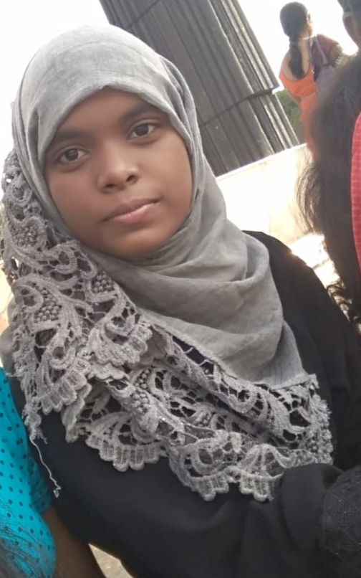
My name is Sofia Tarannum

Slide 3
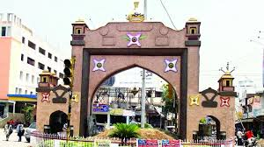
My native place
I’m from karimnagar.

Slide 4
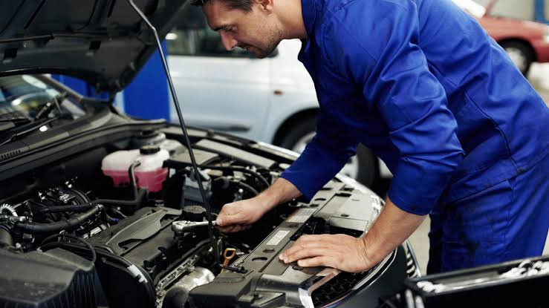

My mom and dad
My father is a mechanic.
My mother is a home maker.

Slide 5
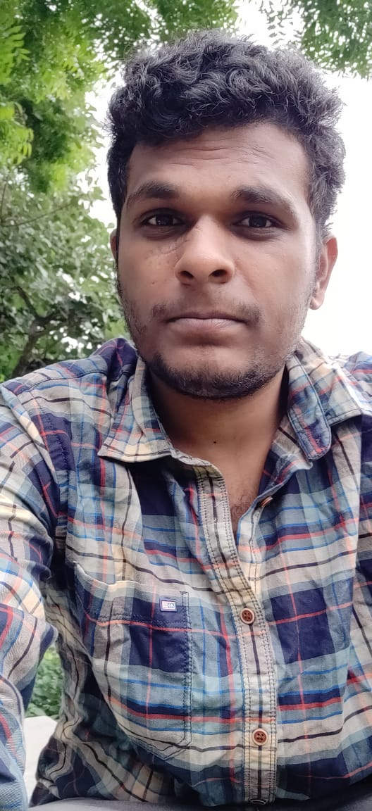
siblings
My elder brother.
He is working in TCS.
Ex alumni of KITS.

Slide 6


hobbies
Listening to music.
Reading books.

Slide 7
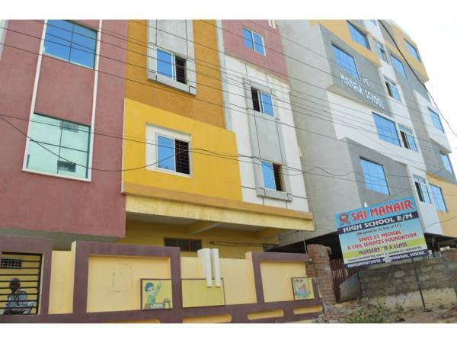
education
Schooling in sai manair high School.

Slide 8
Intermediate in Trinity junior college.

Slide 9
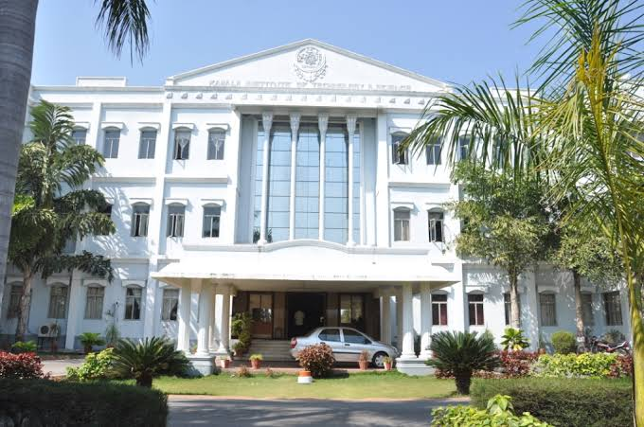
Engineering in Kamala institute of technology and science.

Slide 10
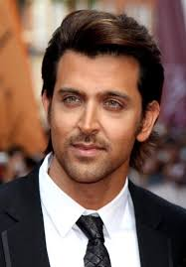
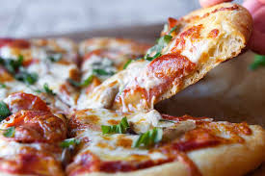
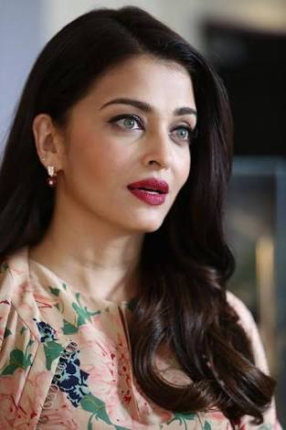
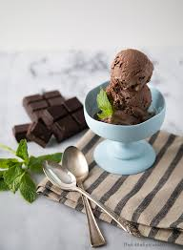
My favourites

Slide 11
My strength
Honest.
Dedicated.

Slide 12
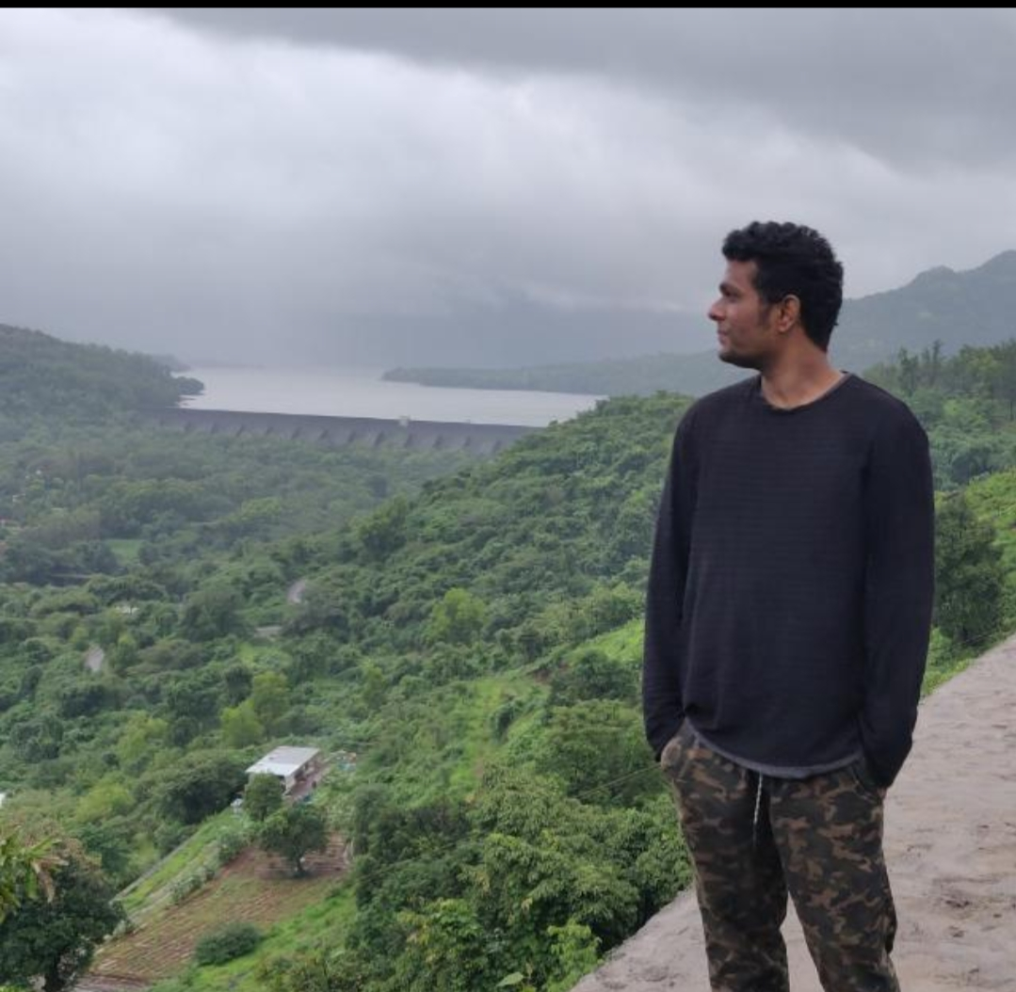
My inspiration
My brother.

Slide 13

My ambition
To establish my own school.

Slide 14
Thank you

